Slide 1
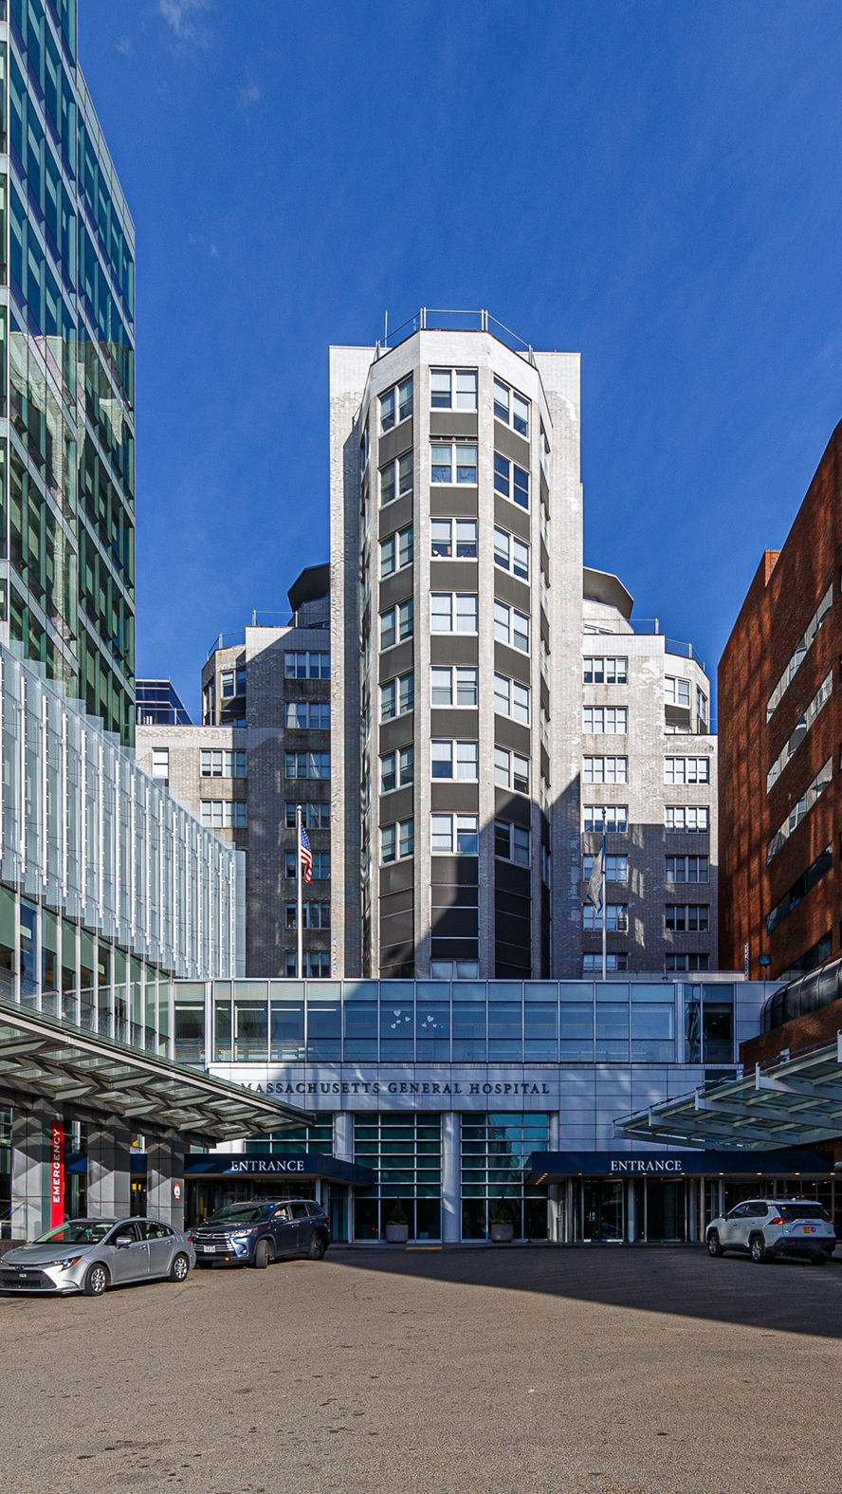


OPPORTUNITY REVIEW
DIRECT-TO-EMPLOYER GTM STRATEGY
Exploring a Mass General Brigham DTE Health Plan

Slide 2


Founded in 1979, headquartered in Indianapolis
Largest Independently-Owned Full-Service Third-Party Administrator
Specialize in Administration of Self-Funded Plans and Population Health Management​
Leader in the Direct-to-Employer Movement
We Know and Understand the Market
Experience Working with All Professional Teams: Agents, Networks, MGAs
The Key Family of Companies is a Vertically Integrated group of benefit related organizations
3,000+ Corporate Clients
3 Million Members under Management
700 Employees

Slide 3


MARKET LEADER
IN
PRIVATE LABELED
DTE PLANS
Louisville, KY
OneHealth Plan
Cincinnati, OH
TCH Optimal
Bentonville, AR
Northwest Health Plan
Knoxville, TN
East Tennessee Health Plan
Meridian, MS
Affinity Health Plan
Fort Myers, FL
Lee Health Care Partners

Slide 4


DIRECT-TO-EMPLOYER (DTE)
YOU Pick the Name of the Health Plan
YOU Determine the Fees Charged
YOU Practice the Medicine
YOU Receive the Profits
WE Make it Successful
Your Health Plan Focused on a Direct Relationship with Self-Funded Employers in Your Market

Slide 5
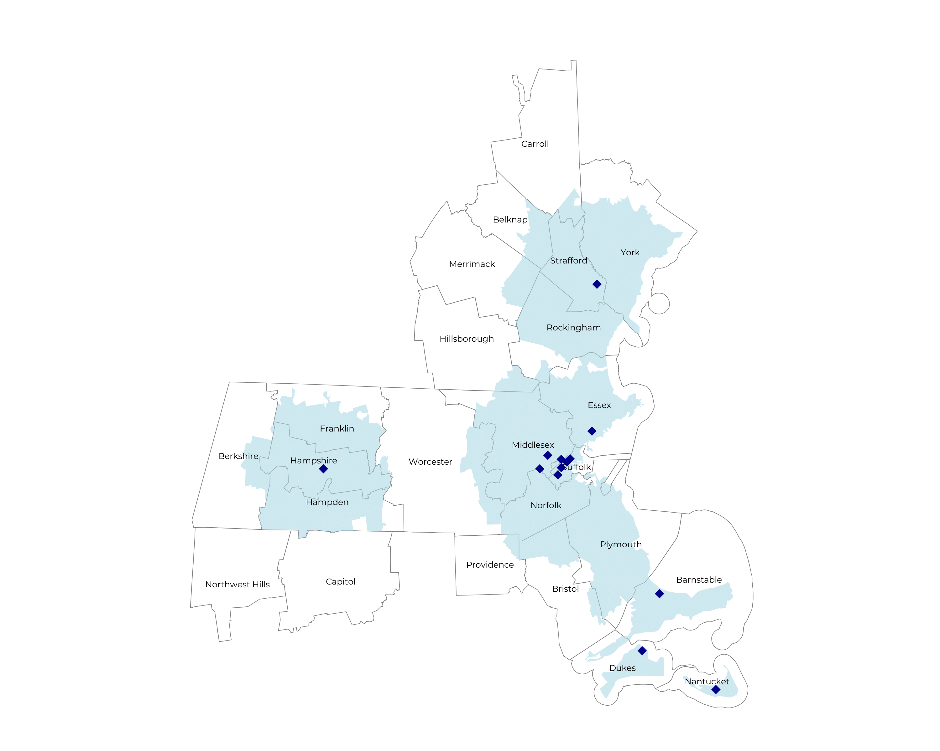
SIGNIFICANT OPPORTUNITY FOR PLAN GROWTH Researched for the below highlighted service area
Target Market 12,000+ Employers 1,600,000+ Employees 280,000+ Members
 | Employer Size Group (# of Employees)
Commercial Employers With Headquarters | 50-100 | 101-200 | 201-400 | 401-1,000 | 1,001-3,000 | 3,000+
In Catchment Area | 6,319 | 2,899 | 1,628 | 1,012 | 362 | 204
Total Employees at Employers | 50-100 | 101-200 | 201-400 | 401-1,000 | 1,001-3,000 | 3,000+
Headquartered in Catchment Area | 473,900 | 434,900 | 488,400 | 708,400 | 724,000 | 1,224,000
Total Members with Employers | 50-100 | 101-200 | 201-400 | 401-1,000 | 1,001-3,000 | 3,000+
Headquartered in Catchment Area | 853,000 | 782,800 | 879,100 | 1,275,100 | 1,303,200 | 2,203,200

Slide 6
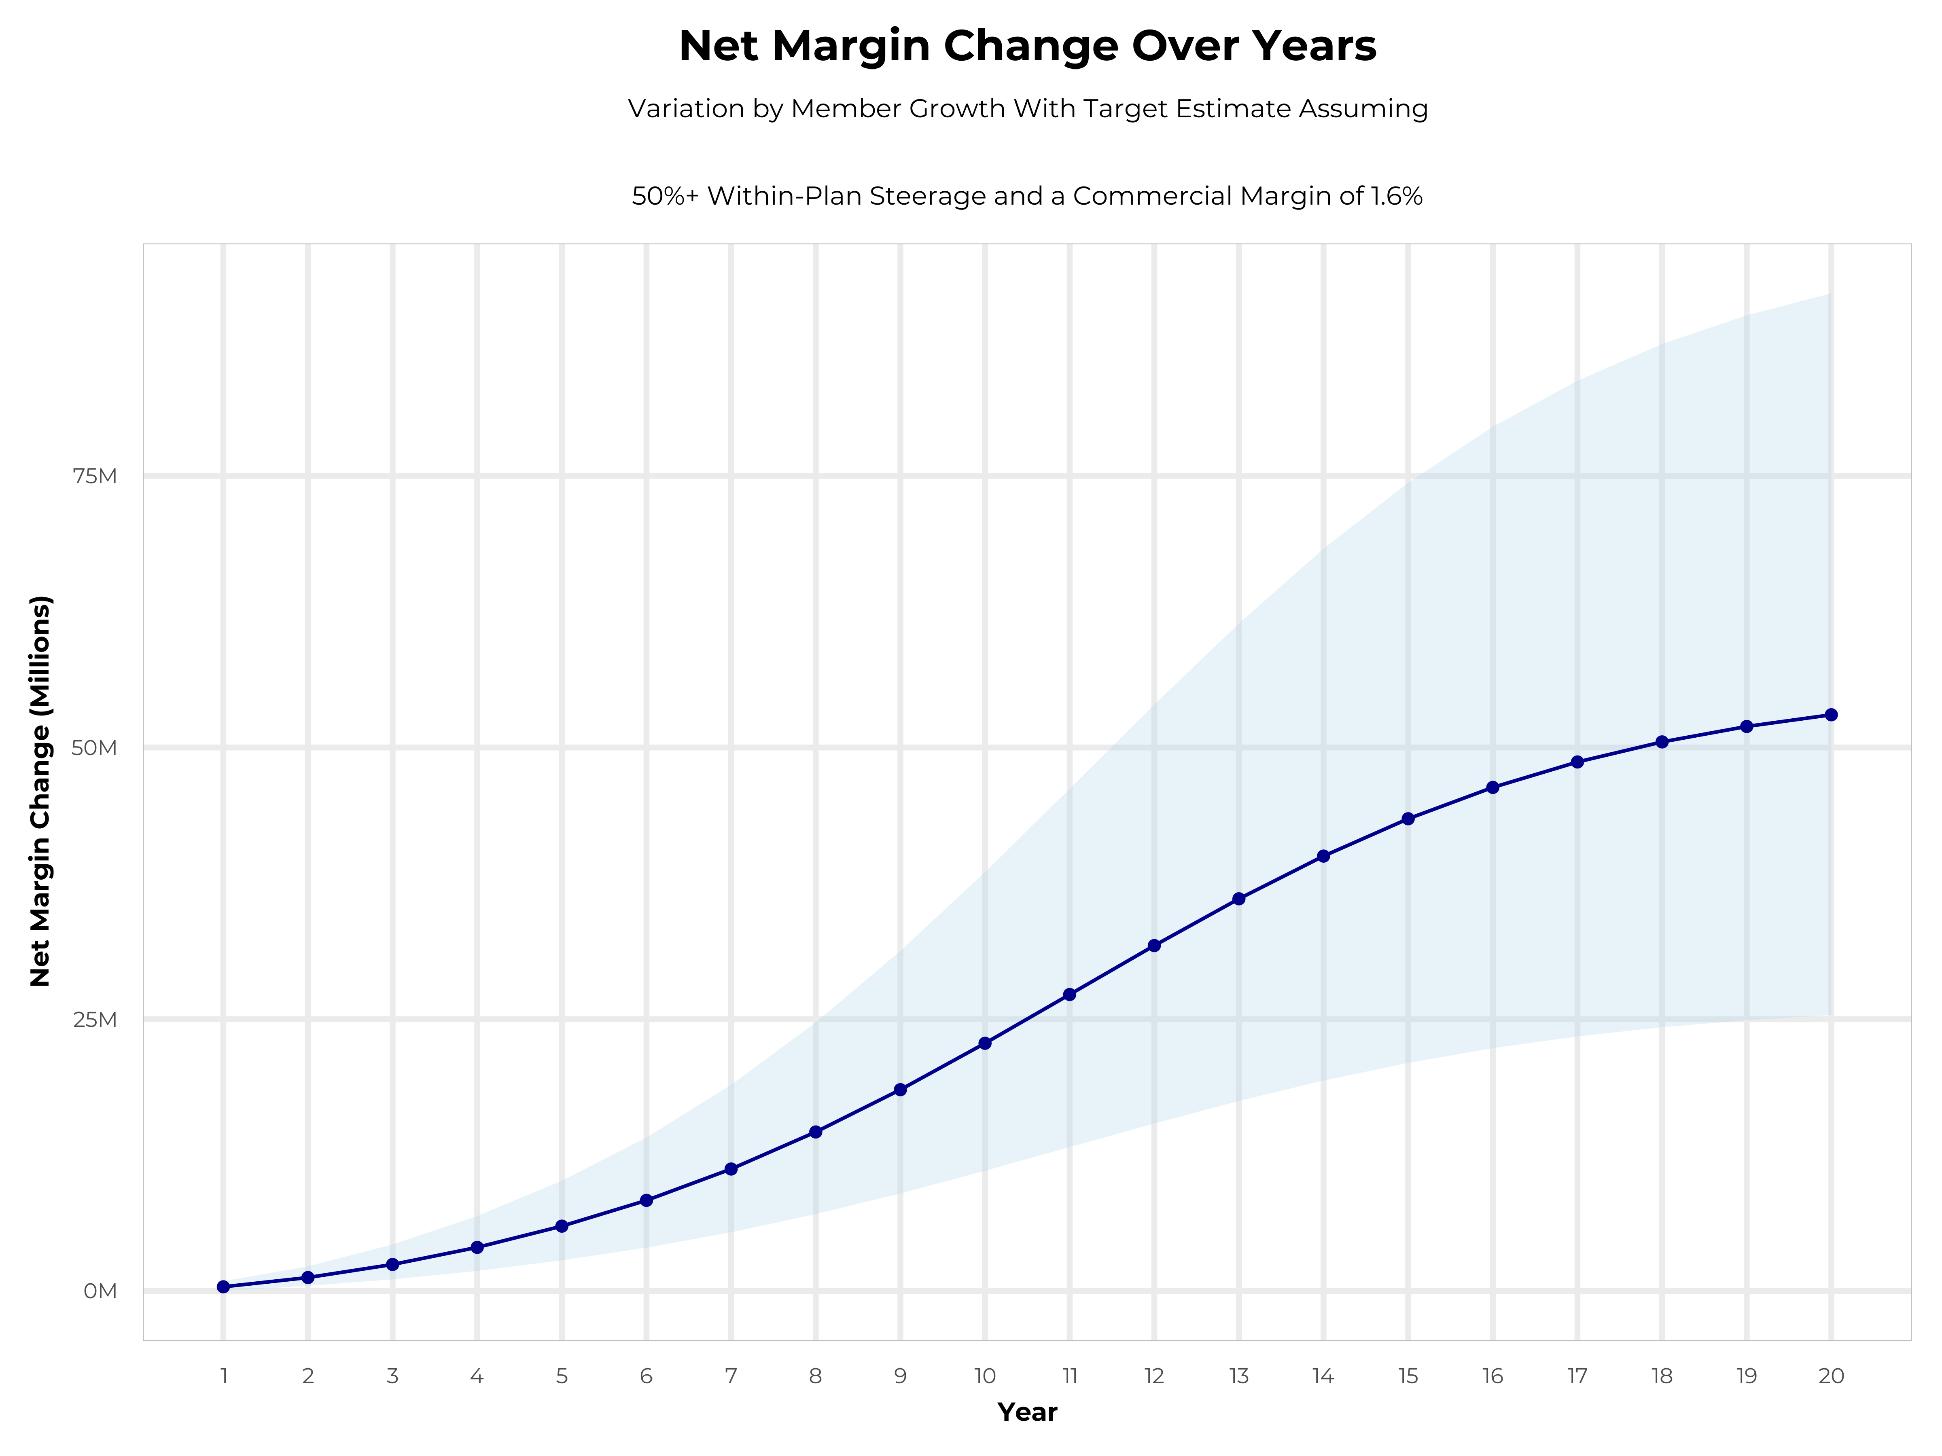
GROWING POWERFUL, LASTING PROFITABILITY
Early Stage
Gaining Name Recognition, Early Growth
New Revenue:
New Profit:
$106.52M
$3.72M
Growth Stage
Strong Reputation, Strong Growth
New Revenue:
New Profit:
$642.75M
$23.18M
Mature Stage
High Profitability, Market Saturation
New Revenue:
New Profit:
$1327.47M
$47.7M

Slide 7
DIRECT-TO-EMPLOYER STRATEGY: ONLY AVAILABLE TO PREMIER HEALTH SYSTEMS
STRONG Brand Quality
EXTENSIVE Patient Access
AFFORDABLE Value Pricing
EXCELLENT Care Quality

Slide 8
Health System | HCAHPS Recommendation Percentile | CMS Stars Percentile | Mortality Percentile | Readmission Percentile | KBA Brand Quality Score
Mass General Brigham | 83 | 98 | 72 | 65 | 72
Catholic Medical Center | 78 | 87 | 73 | 66 | 72
Lifespan | 68 | 100 | 80 | 69 | 68
Boston Medical Center Corporation | 61 | 60 | 75 | 56 | 67
Capital Region Health Care | 58 | 60 | 71 | 64 | 67
Beth Israel Lahey Health | 61 | 87 | 68 | 60 | 65
Covenant Health (MA) | 54 | 87 | 74 | 81 | 64
SolutionHealth | 48 | 60 | 69 | 59 | 63
Trinity Health | 47 | 60 | 66 | 53 | 63
Holyoke Medical Center | 46 | 31 | 56 | 53 | 62
Other Independent Hospitals | 48 | 56 | 63 | 59 | 61
South Shore Health | 46 | 87 | 50 | 55 | 61
Cambridge Health Alliance | 40 | 60 | 62 | 71 | 60
UMass Memorial Health Care | 42 | 77 | 65 | 53 | 59
Tufts Medicine | 39 | 56 | 65 | 46 | 59
Cape Cod Healthcare | 40 | 67 | 75 | 51 | 59
Baystate Health | 31 | 23 | 65 | 48 | 55
HCA Healthcare | 27 | 63 | 73 | 58 | 54
MaineHealth | 21 | 60 | 62 | 82 | 51
Prime Healthcare Services | 12 | 60 | 71 | 49 | 49
Steward Health Care System | 12 | 28 | 73 | 50 | 48
Tenet Healthcare | 6 | 31 | 63 | 60 | 46
Mass General Brigham is the most recommended health system in York, Barnstable, Berkshire, Bristol, Dukes, Essex, Franklin, Hampden, Hampshire, Middlesex, Nantucket, Norfolk, Plymouth, Suffolk, Worcester, Belknap, Carroll, Hillsborough, Merrimack, Rockingham, Strafford, and Providence Counties.

Slide 9
PROJECTED PLAN GROWTH
Year | Employees | Members | Percent of Members Choosing Mass General Brigham for Inpatient Care | Percent of Members Choosing Mass General Brigham for Outpatient Care
1 | 4,600 | 8,300 | 60% | 50%
2 | 9,200 | 16,600 | 60% | 50%
3 | 15,200 | 27,400 | 65% | 55%
4 | 22,900 | 41,200 | 67% | 58%
5 | 32,500 | 58,500 | 68% | 60%
6 | 44,500 | 80,100 | 68% | 60%
7 | 58,900 | 106,000 | 69% | 61%
8 | 75,700 | 136,300 | 69% | 62%
9 | 94,700 | 170,500 | 69% | 62%
10 | 115,200 | 207,400 | 70% | 63%
11 | 136,300 | 245,300 | 70% | 63%
12 | 157,000 | 282,600 | 70% | 64%
13 | 176,300 | 317,300 | 71% | 64%
14 | 193,400 | 348,100 | 71% | 65%
15 | 208,000 | 374,400 | 71% | 66%
16 | 219,900 | 395,800 | 72% | 66%
17 | 229,300 | 412,700 | 72% | 66%
18 | 236,600 | 425,900 | 72% | 67%
19 | 242,200 | 436,000 | 72% | 67%
20 | 246,300 | 443,300 | 72% | 67%
KBA currently estimates that Mass General Brigham has 32% inpatient market share, and 16% outpatient market compared to hospitals/clinics in the Mass General Brigham service area (see slide 8).
Based on previous DTE experience, KBA expects a significant bump in patient steerage to Mass General Brigham.
Additional steerage will occur from additional steerage patient benefits and the patient card.
High estimates start nearly 10% higher than target with low estimates at 10% lower than target

Slide 10
YEAR 4 PROJECTED REVENUE AND PROFIT
Pre-DTE Cohort of 41,100 Employees | Inpatient | Outpatient | Professional | Total
Revenue† | $ 45,113,287 | $ 41,134,335 | $ 19,209,385 | $ 105,457,007
Net Income‡ | $ 1,443,625 | $ 1,316,299 | $ 614,700.3 | $ 3,374,624
† Assuming proportional revenues from market shares of 32% (inpatient) and 16% (outpatient)
‡ Conservatively assuming a commercial margin of 3.2% (80% of the estimated commercial margin)
With DTE | Inpatient | Outpatient | Professional | Total
Revenue⁰ | $ 93,845,190 | $ 147,167,265 | $ 68,725,861 | $ 309,738,316
Net Income* | $ 3,003,046 | $ 4,709,352 | $ 2,199,228 | $ 9,911,626
⁰ Assuming 67% inpatient and 58% market steerage based on KBA narrow network DTE experience (see previous slide)
* Conservatively assuming a commercial margin of 3.2%, with a 10 percentage-point reduction to reflect competitive-edge rates and a 10 percentage-point increase due to lower billing costs and higher patient responsibility collections because of the member credit card.
Total Increase in Net Income | $ 6,537,002
Network Access Fee (Revenue) of $1 PMPM | $ 493,200
Total Profit Growth | $ 6,541,802
Minus Implementation Fee (One-Time) | -$ 0
Minus Sales and Marketing (Annual – Ongoing) | -$ 180,000
Total | $ 6,850,202

Slide 11





A PARTNER YOU CAN TRUST
OUR OBJECTIVES ARE ALIGNED
WE KNOW THE
MARKET
COMPLETELY TRANSPARENT
WE HAVE THE SOPHISTICATION AND INFRASTRUCTURE TO EFFECTIVELY COMPETE
Derek Moore, Senior Vice President – KBA
845-283-9973 * derek.moore@keybenefit.com

